Slide 1
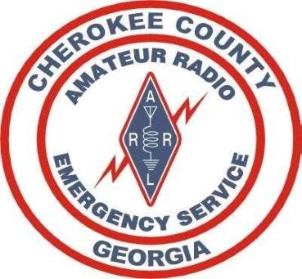
Cherokee County ARES Basics of Emergency Communications Annual Review
8 April 2023

Slide 2
References
Cherokee County ARES Operations Manual

Slide 3
Activation/Deployment
®
We deploy only when requested by our served agency, and only when approved by your Emergency Coordinator of Cherokee County, or one of the delegated Assistant Emergency Coordinators.
Routine Activations:
SKYWARN
Cherokee/ARRL Simulated Emergency Training (SET)
Routine Deployments:
Georgia Death Race
GA Jewel Race
Field Day

Slide 4
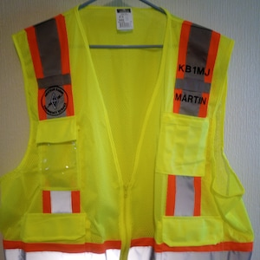
Personal Checklist
Personal Checklist (Part 1- Cherokee ARES Member Checklist)
Ensure you have all of your personal requirements including:
Cherokee ARES SOP and 10 copies of each form printed out and ready to go…
Safety Vest
Meds
Food
Water
Clothing (Cold/Wet Weather/etc)
Table
Chair
Paper
Pen
Flashlight / Headlamp
Coffee and means to brew (Your Team will appreciate)
Etc…

Slide 5
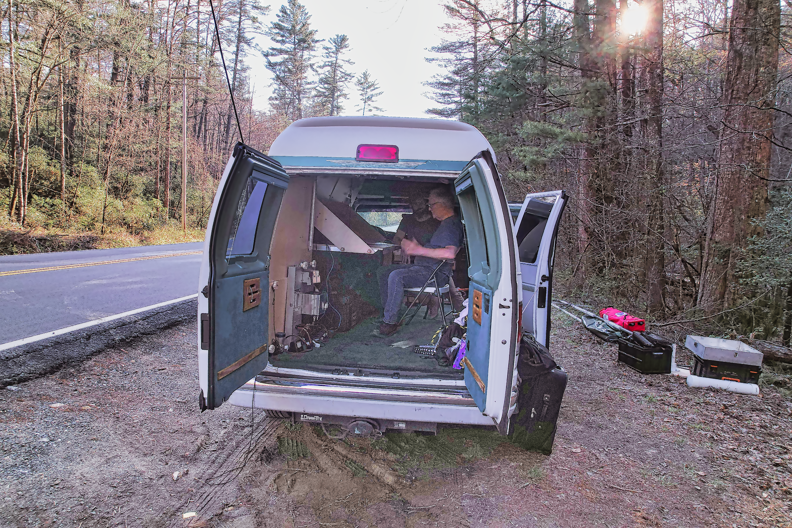
Equipment Checklists
Equipment Checklist (Part 1- Cherokee ARES Member Checklist)
Radios
HF Antenna Tuner
Antenna Analyzer
Cables
Headphones/Mics
Power Supply
Battery’s
Solar/Generator
Winlink is Updated with current Version and Forms
Winlink is Updated with current Propagation for Grid Square/Modes
HF Antennas
VHF/UHF Antennas
Coax and Connectors
Material to Hang Antenna (Paracord, Poles, Slingshot/Antenna Launcher)
Engineer/Safety Marking Tape
Etc…

Slide 6
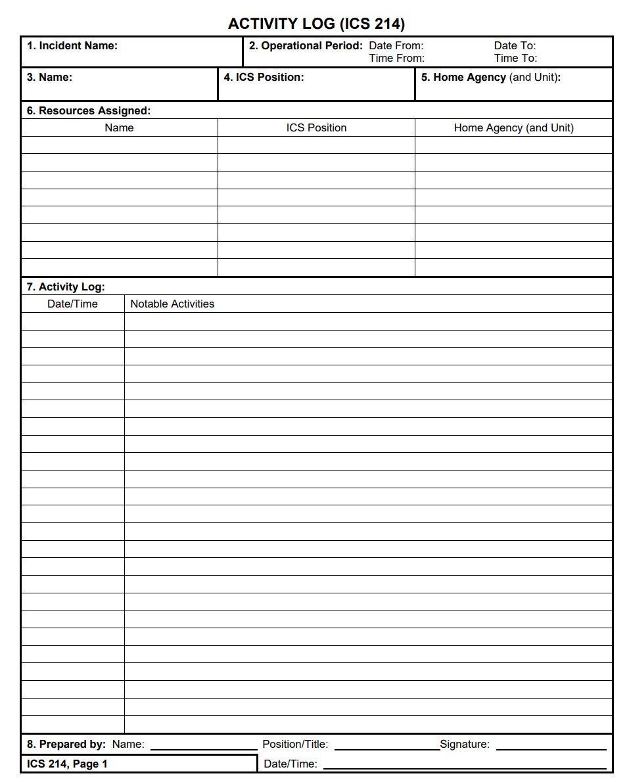
Process
Initiate ICS214. Track all significant activates/events including (Section 6.1.1)
Activation Time
Deactivation time
When you left and returned to your Home Station
Time you reported into to Incident Commander
Time you were mission ready/equipment setup
Etc
Conduct map/internet recon of area deploying to if possible.
Identify resupply points (Gas, Food, Water, Emergency Services)
Identify Hazards (Terrain, Weather, etc)
Identify Potential Winlink Gateways and Voice Repeaters in the area
Conduct Personal Risk Assessment (Mitigate Medium and High Risks)
Notify Family of your plans/route/expected date of return
Setup ability to communicate with family, let them know you are safe and arrived on site (Winlink Email, Winlink SMS, APRS-SMS (SMSGTE), etc)

Slide 7
Process
Communicate in plane spoken English.
Do not use Radio terms, Q-Codes, 10-Codes
Use Phonetic Alphabet and Numbers when communicating or spelling
Use Prowords correctly
Be Professional, reminder IC is in charge, we work for the IC / team assigned.
Remain Flexible, Calm, Adapt, Think Outside of the Box, and Accomplish the Mission
We will assign Positions/Tactical Callsigns as needed, Example:
Point Bravo Command
Point Bravo Intake
Point Bravo Aid-Station

Slide 8
Focus Skills
The Following Skills are key to Cherokee ARES Success
Ability to be comfortable, communicating via Phone/Voice on your radio or an assigned radio.
Understand ICS and take required training as laid out in the Individual Task Book /CCARES OPS Manual.
Ability to manage your radio configuration (Add/Edit/Delete) frequencies, Offsets, and PL Tones.
Ability to perform Winlink Messaging using free-form and forms contained within solution, ability to manage Winlink Configuration including your Tactical Callsign, Grid Square, GPS Location, etc…
Ability to proficiently utilize DRATS over Internet for Chat via #CCARES Channel, Update your Coordinates, and utilize MAP.
Go Box standardization with Power Distribution (11.1- PowerPoles). You may need to leverage someone elses power or someone else may need to leverage your power solution.
Ability to Follow-Directions! Do what NCS or Incident Commander Asks for.
Have a Great Attitude, remain Flexible, remain Professional, and use every opportunity to Learn and Improve…
Bonus Skills:
RF Winlink (Vara HF, VARA FM, VARA P2P)
Deployment Skills (Battery/Solar Power, VHF/HF Antenna under adverse conditions, etc) --- POTA Great Training Tool

Slide 9
Cherokee ARES Review

Slide 10
Welcome
Welcome to the Cherokee County, Georgia Amateur Radio Emergency Service®
While amateur radio is a hobby, we encourage you to participate in our weekly nets, various drills/exercises throughout the year, and be prepared to answer the call from our community when emergency communications are needed.
We are NOT storm-chasers, nor are we First-Responders.
We are a dedicated group of amateur radio operators that follow the chain of command.
We deploy only when requested by our served agency, and only when approved by your Emergency Coordinator of Cherokee County, or one of the delegated Assistant Emergency Coordinators.

Slide 11
Introduction
Taking part in a Formal or Directed net and learning how to handle traffic are perhaps the major qualifications required of an ARES/RACES team member.
Being a successful participant of an ARES/RACES net, requires exercising discipline, and observing a few basic rules of the road.

Slide 12
Net Communications
Ground Rules for participating during a Directed / Formal Net:
During a Directed Net, Only use the frequency for official traffic.
LISTEN. The Net Control Station (NCS) will provide instructions on how to check into the net and what is expected during net activities.
Follow the net protocol established by the NCS.
If you need to talk to someone directly, ask the NCS for permission.

Slide 13
Net Communications (cont)
Ground Rules for participating during a Directed / Formal Net:
Answer promptly when called by the NCS.
If you leave your station during a Directed Net, Inform NCS and Request Permission to “Close-Down”.
Properly Utilize Prowords.
Properly Utilize ITU Phonetics for Spelling and for providing Figures/Numbers.

Slide 14
Net Communications (cont)
Ground Rules for participating during a Directed / Formal Net:
Do not break into an active on-going net. WAIT until NCS calls for check-ins or late checkins- UNLESS you have Priority Emergency Traffic.
Do not utilize Q-Signals, 10 Codes, etc. Speak normally in clear language.
For Example:
Do not use QSL to Acknowledge a message, instead use the Proword, 'Acknowledge-Over’.
This is important as we will be working with many different Served Agencies and the communications must be fully understood by all parties. (Including National Weather Service, American Red Cross, Georgia Emergency Management Agency, Local County and City agencies, etc.)

Slide 15
Prowords
What are Prowords?
Procedural Words are used in message handling to ensure accuracy and efficiency.

Slide 16
Common Prowords
Below is a list of Common Prowords we shall utilize. Emergency Communications requires clearly spoken language to avoid any confusion or miss-interpretation of meaning:
CORRECT / WRONG. The proword CORRECT means "what you transmitted is correct". The opposite is WRONG.
NEGATIVE / AFFIRMATIVE. The proword NEGATIVE means "No". The Opposite "AFFIRMATIVE" meaning "Yes".
SAY AGAIN. The proword SAY AGAIN is used to request a repetition of something that was transmitted. The Proword I SAY AGAIN means I am about to restate something I have already transmitted.
WAIT and WAITOUT. The proword WAIT is used when a pause is required and will last less than five seconds. Wait should not be over-used; you may simply pause a second or two without saying it. WAIT OUT means I must pause for longer than five seconds before continuing/responding, in the meantime other stations can transmit as normal.
BREAK. The proword BREAK indicated separation between the heading and the text and between the text and the end procedure. Break is not used to interruption transmissions.

Slide 17
Common Prowords (Cont)
PRIOIRTY. The proword PRIORITY, is used to prioritize traffic and can be used to interrupt the communications by stating the precedence of his/her traffic. E.g., “PRIORITY PRIORITY”. NCS upon hearing the interruption will seize control of the net , stop the communications so that the higher precedence of traffic can be passed.
WILCO. The proword WILCO is a contraction of the phrase "will comply". It is used in response to a request or tasking and means that you understand the tasking and agree to accomplish the task. Because it implies you understand the request, it is never used with the proword ROGER as that would be redundant.
OVER. The proword OVER means, I have finished my transmission, go ahead and transmit.
OUT. The proword OUT means, I have concluded my transmission, no reply is expected.
ROGER. The proword ROGER means, "I have received the information by you" without indicating approval or disapproval, agreement or disagreement. Do not confuse ROGER for WILCO.
THIS IS. The proword THIS IS means, "The current transmission is from the station who's call sign follows." This proword can be omitted after communications are established.

Slide 18
Common Prowords (Cont)
THIS IS A DIRECTED NET. This proword THIS IS A DIRECTED NET, spoken by NET Control, means that until further notice the NET is directed. This means that all stations need permission of NET CONTROL to call other stations. The Opposite is FREE NET. In a FREE NET, any station may call any other station without NCS Permission.
CLOSE-DOWN. The proword CLOSE-DOWN can be used to request your station to leave the net, or used by Net Control to End the Net.
UNKNOWN STATION. The proword UNKNOWN STATION means, “the identify of the station I am attempting to contact is not known to me or whose callsign was not heard or only partially heard.
WORDS TWICE. The proword WORDS TWICE is used when communication is difficult. The station is requested to transmit the phrase twice that is trying to be communicated in an attempt to understand the message.

Slide 19
Common Prowords (Cont)
FIGURES. The proword FIGURES means, you are about to transmit numbers. FIGURES is not used in conjunction with the prowords TIME, GROUPS, NUMBER, CALL SIGN, or FREQUENCY. FIGURES is used to distinguish the numerical form versus textual form, (i.e., to distinguish “2” from “two”). FIGURES is not needed in these situations: “Change frequency to 146 decimal 640, OUT.
I SPELL. The proword I SPELL is used to spell the previous word or letters communicated. When used, Say the Word, Say the proword I SPELL, spell the word Phonetically, Say the Word again, continue with your message.
Example:
This is W1JKU, report to Lane, I SPELL Lima Alpha, November, Echo Lane Street immediately, Over.
IF you did not spell Lane phonetically, might the receiver have thought they heard Main Street?

Slide 20
ITU Phonetics
What is ITU Phonetics?
Why do we use ITU Phonetics?
The ITU Phonetic Alphabet standard is also called the NATO Phonetic Alphabet.
This standard of phonetics is currently used by the military, civilians, aviators, and radio communicators across the globe.
The Phonetic Alphabet is used when spelling out Words or Numbers over radios, telephone lines, etc. This ensures that there are no misunderstandings.
The standardization provided by using one form of communication also makes it easier to provide clear instructions without confusion or mistakes being made due to miscommunication during an emergency situation.

Slide 21
ITU Phonetics (Cont)
What you hear on HF /Contesting normally DOES NOT adhere to ITU Phonetics.
Operators are making “Cute” Names for Letters, which adds to confusion.
Do not set yourself up for failure and utilize non-ITU Phonetics. It’s then a hard habit to break!
We WILL NOT utilize Non-Standard ITU Phonetics on our Directed Nets

Slide 22
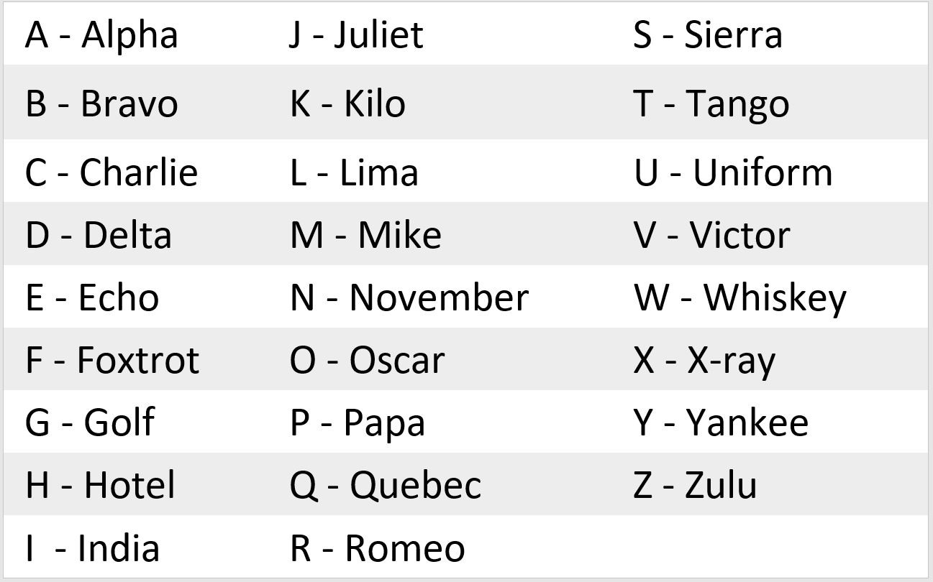
ITU Phonetics (Cont)
ITU Phonetic Alphabet- Letters

Slide 23
ITU Phonetics (Cont)
ITU Phonetic Alphabet- Numbers
Numbers in the phonetic alphabet also have their own pronunciations. Most of them are pronounced as you normally would, a few however, are modified to provide a clearer sound definition.
Number | Phonetic Word | Pronunciation
0 | Zero | zee-roh
1 | One | wun
2 | Two | too
3 | Tree | tree
4 | Fower | fa-wer
5 | Fife | fife
6 | Six | siks
7 | Seven | seh-vin
8 | Eight | ate
9 | Niner | ny-ner

Slide 24
ITU Phonetics (Cont)
If you are Net Control, do not Respond back with Non-Standard ITU Phonetic, give the correct spelling.
Make on the Spot Corrections.
We must enforce the standard, else there is no standard.
Our Served Agency’s we are supporting and our community, requires we remain disciplined and properly communicate so no message is misunderstood or transferred incorrectly!
An incorrectly transmitted message could make a difference of mission success/failure, (life or death).

Slide 25
Passing Formal Traffic
During an emergency, precise message handling is critical. It is important to record and pass on messages quickly and accurately.
Keep Transmissions to a minimum.
Avoid Spreading Rumours – Don’t expand or speculate on what you may hear on the air or while in the presence of officials.
All “official messages” should be written and signed by the originator.
Send formal traffic EXACTLY as you received it. Don’t correct it, change it, elaborate, or try to interpret it. Ask for clarification before Sending.
Copy it as you received it. Send it as you were requested.
Use the right mode and band to suit the need.

Slide 26
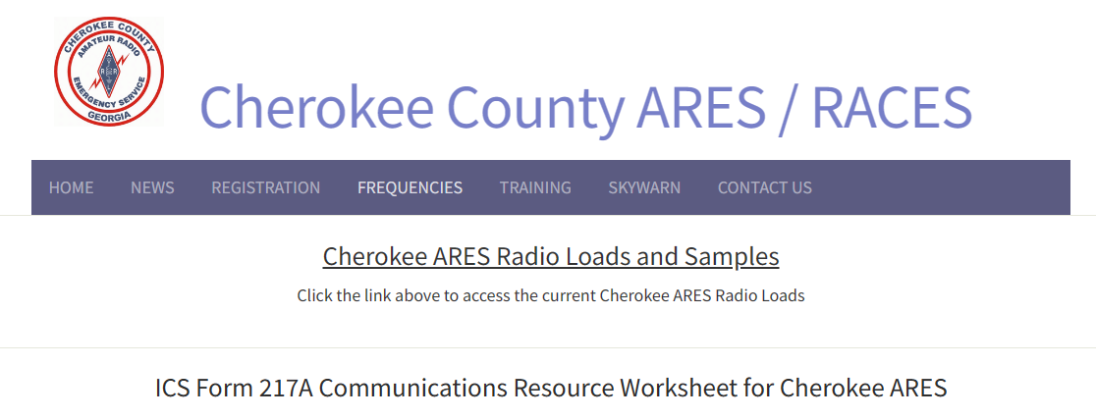
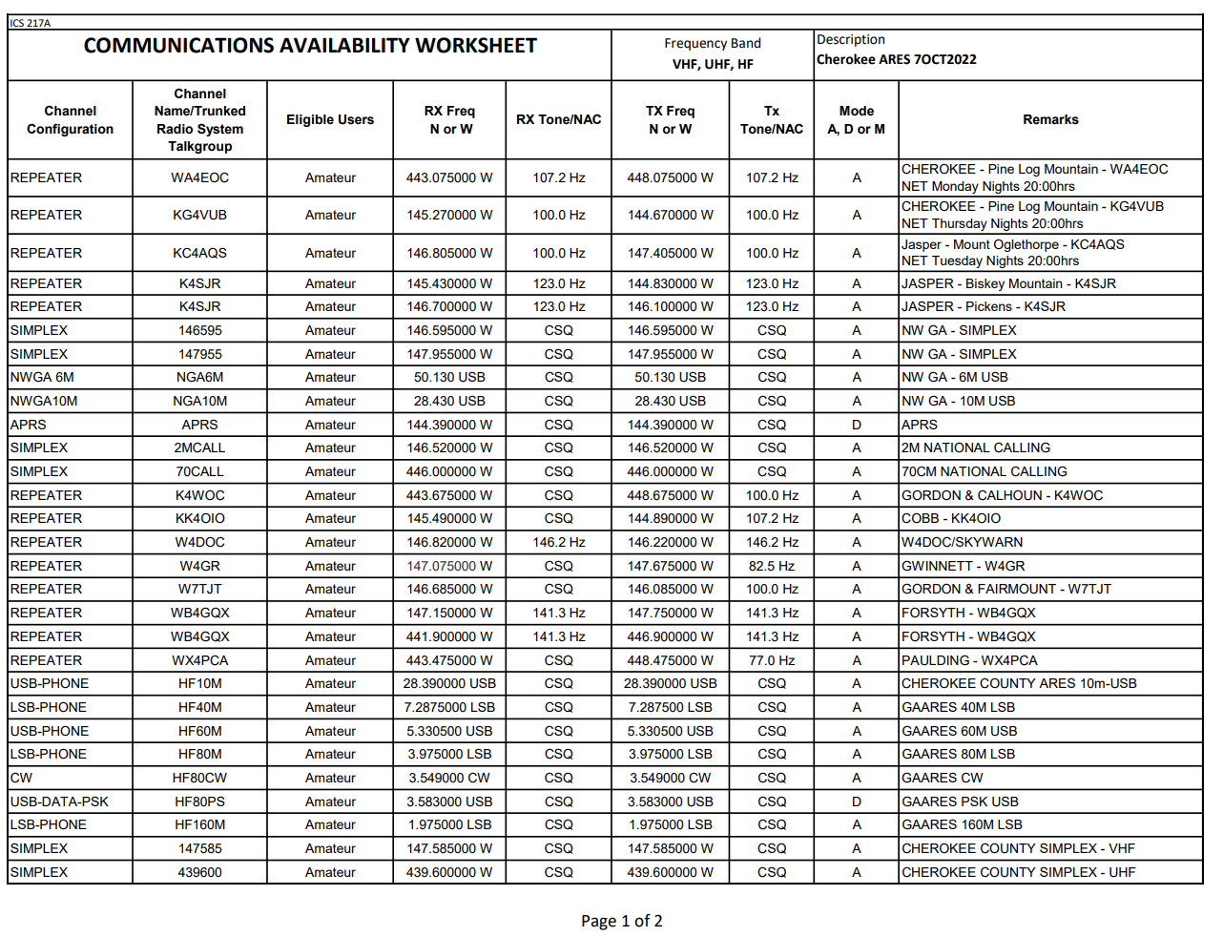
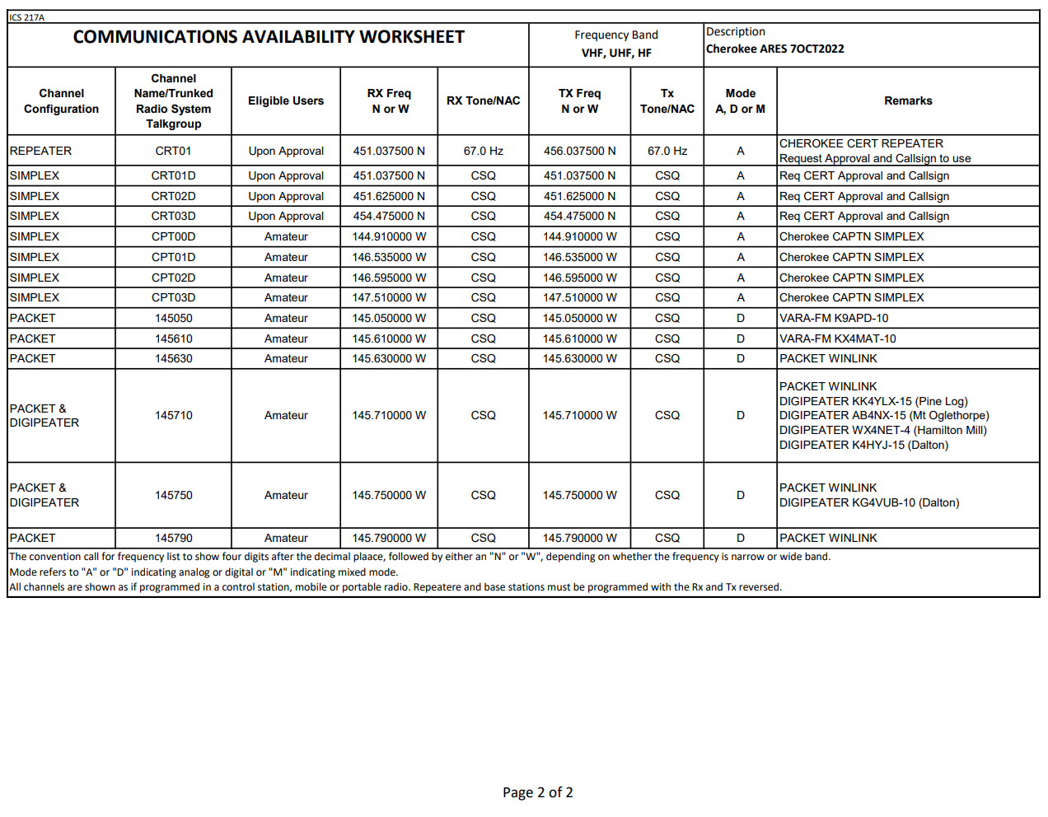
Frequencies
ICS-217A- Communications Availability Worksheet
Worksheet includes all ARES approved Frequencies for Cherokee, our District, and surrounding communities.
Worksheet does not include DMR, Fusion or any other mode reliant on the internet or limited to a small group of individuals.
If you have not updated your radio with these frequencies, you are encouraged to do so, prior to an activation or deployment.
Check your Radios. If you still have outdated frequencies in your radio including Simplex into our WA4EOC, K4VUB, or KC4AGS repeater, remove those now… On a regular basis members are incorrectly attempting to join the net on the wrong Frequency…

Slide 27
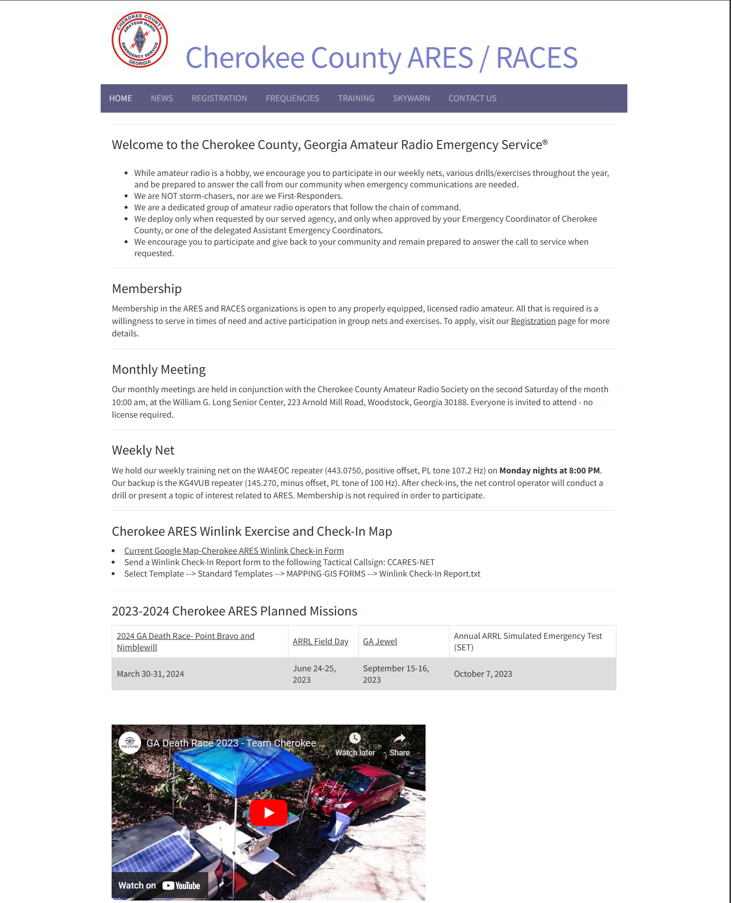
Cherokee ARES Website
http://Cherokee-ARES.org
Moved link to our Winlink Exercise and Check-in Map. During an Activation, this Map will be updated as needed to reflect our current situation.

Slide 28
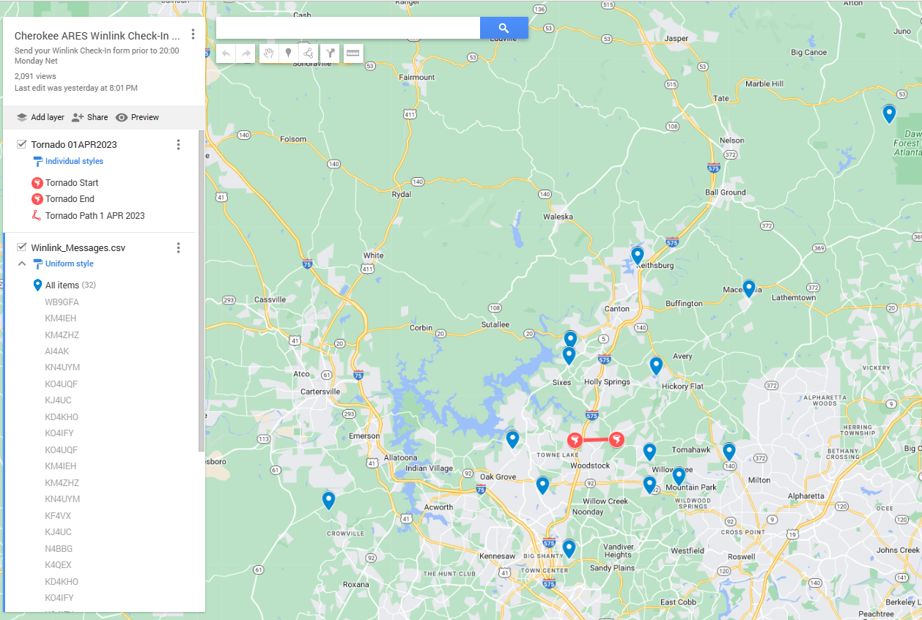
Cherokee ARES Website
Current Google Map-Cherokee ARES Winlink Check-in Form

Slide 29
Weekly ARES Training NETS
To help prioritize the nets for the Cherokee ARES teams, we are requesting that we participate, as time allows, on the Cherokee ARES, Cherokee CARS, and NW GA ARES weekly nets.
By keeping focus on our County and District we are better able to mutually support one another during an activation or incident.
Monday
Cherokee ARES /SKYWARN
20:00 hours Net starts on WA4EOC Repeater (443.075 + PL 107.2) and Alternate Repeater KG4VUB (145.270 - PL 100.0)
Tuesday
NW GA ARES DISTRICT
1st Tuesday 19:30 District Simplex Net (Check NW GA ARES District Facebook weekly)
19:30 Winlink Net – Send Winlink Check-in form to W4NWG
20:00 hours Net starts on KC4AQS Repeater 146.805 + PL 100.0 (Additional Instructions will be provided on the net or NW GA ARES District Facebook)
Exercises varies including:
DSTAR using REF030B
Winlink (Telnet/Vara/Packet) to W4NWG
Winlink P2P- TBD
Simplex Testing VHF/UHF/HF- Based on weekly exercise
DRATS
Thursday
Cherokee Amateur Radio Society Club Net (WX4CAR)
20:00 EST via the KG4VUB Repeater (145.270mHz - PL 100Hz encode and decode)

Slide 30
Cherokee ARES Registration

Slide 31
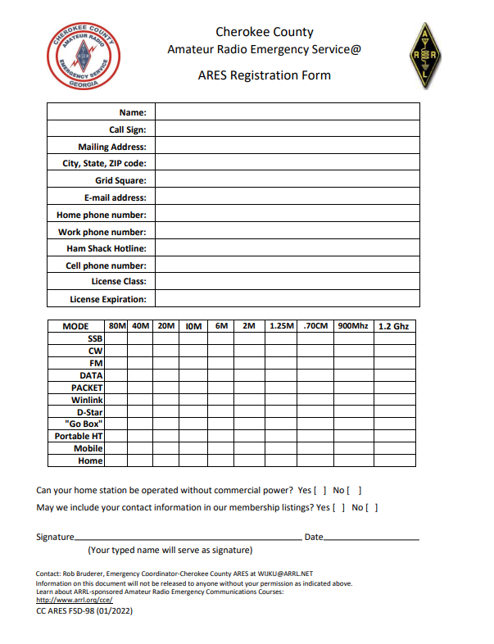
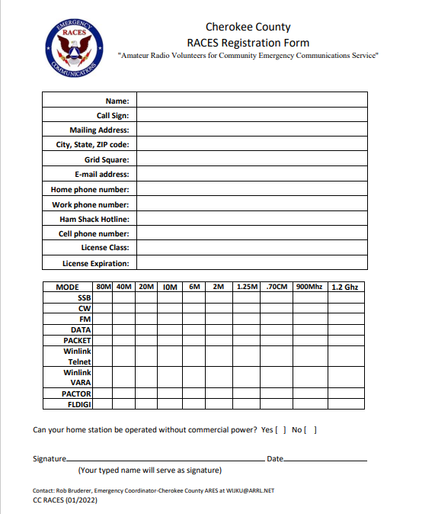
Reminder to Register
Submit your FSD-98 and RACES to Register Form for Cherokee to W1JKU and KO4IFY
Submit your Certificates of Training to W1JKU and KO4IFY
On Monthly Basis, Sign the ARES Sign-in Roster at our Meetings and verify your Contact Information is correct

Slide 32
After Registration
You will be added to the Cherokee ARES Groups.IO
Please follow the steps in the email you receive to accept the invitation, and please set your name in Groups.IO as First name + Callsign
This specific page is limited for Cherokee ARES training, Activations, and Upcoming ARES Events.
For Non-ARES related postings use the WX4CAR Club Groups.IO Page Cherokee-Hams.groups.io
You can then request access to the Cherokee ARES Facebook Page, which for short message/reminders. Only ARES members will be admitted to the page. (Facebook is not mandatory, just another tool in the toolbox to help notify members)
Please access and make a favorite on your web-browser: the Cherokee ARES Website . This is the official site for complete listing of our Operations Manual and important details of our Organization.
Please Establish your own Binder that includes the Cherokee ARES Operations Manual
Please Print 10 Copies of each of the Blank ICS Forms, so you have them available during an incident
Please Check the website at least quarterly for updates. (If we make a major update to this site, we will post a notification on the Cherokee ARES Groups.IO page as a reminder).
Participate in Weekly NETS and Exercises

Slide 33
Participate
Give Back to the Community
Have Fun and Advance your Skills
Quick Overview of our Activities over the last month

Slide 34
GA Death Race 25-26 March 2023

Slide 35
POTA- April 1- 2023

Slide 36
Questions
or
Comments

Slide 37
Thank you!

